Slide 2
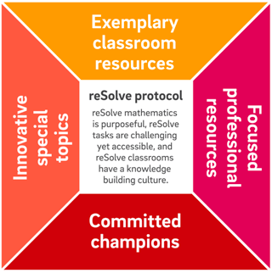
Overview of the reSolve: Mathematics by Inquiry Project

Slide 3
The reSolve Protocol is the driver for all that the project is about, and does.
In order to foster a spirit of inquiry in all mathematics teaching and learning:
reSolve mathematics is purposeful
reSolve tasks are challenging yet accessible
reSolve classrooms have a knowledge-building culture

Slide 4
Classroom Resources
Exemplary classroom resources at every level from Foundation to Year 10 that embody a spirit of inquiry and enact the reSolve Protocol.

Slide 5
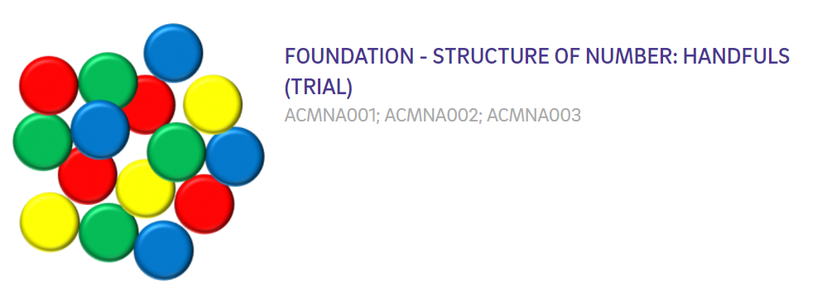
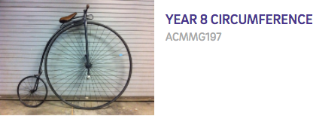
Classroom Resources

Slide 6
Special Topics
Addressing identified needs or exploring new boundaries.
Special Topics are significant resources that address the needs of 21st century learners. They:
are substantial units of work and accompanying resources that address major current gaps;
prioritise the Australian Curriculum proficiencies of reasoning and problem solving;
provide imaginative opportunities for creatively using new technologies and real world contexts;
respond to the results of international assessments showing that solving real problems is a specific area of weakness for Australian students.

Slide 7
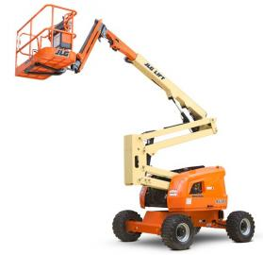
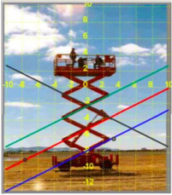
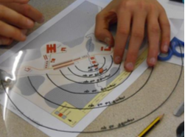
Special Topics
Mechanical Linkages and Deductive Geometry | Bring Algebra into the Real World | Modelling Motion | Bar Model Method
Assessing Reasoning | Mathematics and Algorithmic Thinking | Mathematical Modelling | Mathematical Inquiry into Authentic Problems

Slide 8
Professional Learning Modules
Resources to support in-school leaders to address key issues and themes in the teaching and learning of mathematics through collegial professional learning programs.

Slide 9
Professional Learning Modules
PLM 1: reSolve: Mathematics by Inquiry Introducing the reSolve Protocol and some of the resources | PLM 2: Mathematical purpose and potential | PLM 3: Including all students in mathematics learning experiences | PLM 4: The role of challenging mathematical experiences in activating thinking of all students.
PLM 5: Using student strategies and solutions as part of inquiry learning in mathematics | PLM 6: Leading the incorporation of inquiry approaches into mathematics teaching repertoires: A workshop for current and potential leaders | PLM 7: Activating mathematical thinking then consolidating learning | PLM 8: Adapting existing inquiry resources and creating your own

Slide 10
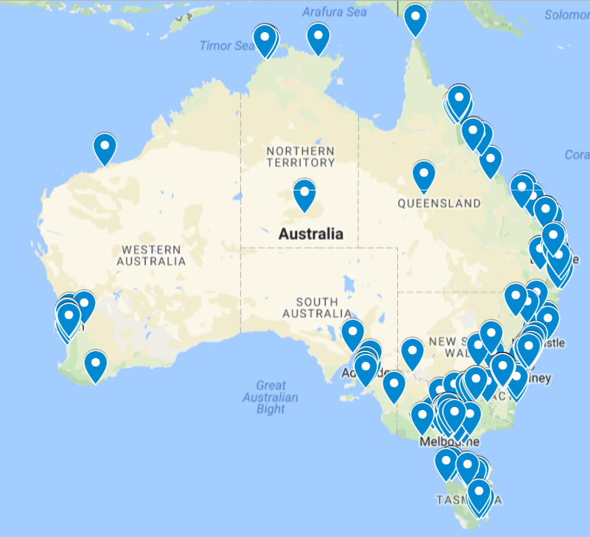
reSolve Champions
A community of more than 290 committed leaders across the country, who will use reSolve resources and approaches in professional learning programs they lead during and after the development phase of reSolve (finishes mid-2018).

